Slide 1

RISK AND RESILIENCE BOOTCAMP
11

Slide 2


Slide 3

Recovery models
This section is an introduction to
Recovery models and processes
Business recovery lifecycles

Slide 4
Operational resilience
After disruptions from any cause
An organization must be able to recover essential functions quickly and effectively
Recovery models
Define how systems, processes, and business functions are restored after an incident: how resilience is implemented
The business recovery life cycle
A structured process for achieving resilience
From identifying critical activities to testing recovery capabilities
These form the core of operational resilience
Ensures that a bank or financial institution can continue serving customers, protect assets, and meet regulatory obligations under stress

Slide 5
Recovery Models
Recovery model
A defined approach or architecture for restoring IT systems, data, and business operations to a functional state following a disruption
Determine where, how, and to what level recovery occurs
Resilience metrics
Models are guided by the resilience measure we saw earlier
RTO (Recovery Time Objective)
The maximum acceptable time a process or system can be unavailable before serious impact occurs
RPO (Recovery Point Objective)
The maximum acceptable amount of data loss measured in time (e.g., 15 minutes, 4 hours)

Slide 6
Recovery Models
Resilience metrics
Models are guided by the resilience measure we saw earlier
MAO (Maximum Acceptable Outage)
The total time a process can be disrupted before organizational viability is threatened
MBCO (Minimum Business Continuity Objective)
The minimum level of output or service that must be maintained during disruption
Recovery Tier / Strategy
A structured level defining recovery speed and infrastructure complexity (e.g., hot site, warm site, cold site)

Slide 7
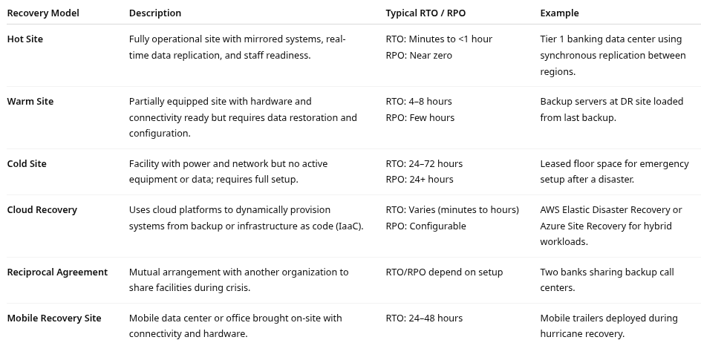
Recovery Model Types

Slide 8
Recovery Process Flow
Recovery Process Flow
The operational execution of resilience
The step-by-step progression
From detecting a disruption through restoring normal business operations
Then updating the appropriate controls
The flow
Detection: Recognize the disruption or incident
Notification: Escalate to recovery or crisis teams
Assessment: Analyze impact and decide if recovery plan activation is required
Activation: Initiate recovery processes (failover, backup restore, alternate site)
Restoration: Restore systems and business operations
Verification: Validate restored systems for accuracy and completeness
Return to Normal: Transition from recovery to standard operations
Post-Incident Review: Evaluate performance and improve plans

Slide 9
Recovery Process Flow
Detection
Identify that a disruptive event, system fault, or threat condition has occurred and determine its potential to affect business operations
Key activities
Continuous monitoring of systems, applications, facilities, and environmental conditions
Use of SIEM, AIOps, or observability tools to detect anomalies, security events, or hardware failures
Event correlation and severity classification (e.g., minor incident vs. critical outage)
Notification from internal staff, vendors, or customers (incident reporting channels)
Responsible roles
Network Operations Center (NOC)
Security Operations Center (SOC)
Monitoring / Site Reliability Engineers (SREs)
Resilience
Early detection reduces Mean Time to Detect (MTTD), minimizing downtime and data loss
Timely detection is a preventive and detective control

Slide 10
Recovery Process Flow
Notification
Alert the appropriate response and recovery teams so that decision-making and containment actions begin immediately.
Key activities
Trigger automated or manual incident escalation workflows via service management tools
Notify Incident Response Team, Crisis Management Team, Communications, and Executive Leadership.
Maintain communication channels: email, phone trees, emergency alert systems, or crisis collaboration platforms
Document timestamps for all notifications to ensure traceability.
Responsible roles
Incident Commander or Recovery Coordinator
IT Operations Manager
Business Continuity Manager (BCM)
Resilience
Proper notification prevents decision delays and chaos
Clear escalation protocols are part of DRII’s “Incident Response” practice, ensuring consistent activation

Slide 11
Recovery Process Flow
Assessment
Evaluate scope, severity, and potential impact to decide if recovery plans should be activated
Key activities
Conduct a rapid impact analysis: Which systems, business processes, and customers are affected?
Compare disruption with RTO and RPO thresholds
Check for regulatory implications, for example, if a disruption affects financial reporting or data privacy
Determine whether to escalate from incident management to crisis management or disaster recovery activation
Engage the Business Impact Analysis (BIA) data to prioritize recovery sequence
Responsible roles
Crisis Manager / Incident Commander
IT Disaster Recovery Lead
Business Function Leaders (process owners)
Resilience
This stage ensures proportionate response
Avoiding overreaction to minor issues while guaranteeing timely activation for critical disruptions

Slide 12
Recovery Process Flow
Activation
Formally declare a recovery event and launch the relevant recovery strategies, procedures, and teams
Key activities
Activate Disaster Recovery (DR) and Business Continuity (BC) plans
Mobilize alternate facilities, hot sites, or cloud recovery environments
Begin system failover, backup restoration, or workload redirection (e.g., to secondary data center or cloud region)
Initiate manual workarounds for critical business processes if IT systems are unavailable
Establish command centers or war rooms to coordinate communication and actions
Responsible roles
Business Continuity Manager
IT DR Team and Infrastructure Leads
Crisis Communications Officer
Resilience
Execution of well-defined, documented, and rehearsed plans that allow faster and safer recovery

Slide 13
Recovery Process Flow
Restoration
Return affected systems and processes to a functional state that allows essential operations to resume
Key activities
Execute technical recovery procedures: restoring servers, databases, network links, and applications in prioritized sequence
Validate data integrity from backups or replicas
Coordinate user acceptance testing (UAT) or “sanity checks” to confirm functionality
Reconnect dependent systems and third-party integration
Resume key business functions under controlled conditions like limited customer traffic
Responsible roles
IT DR Engineers and Database Administrators
Application Owners
Business Recovery Coordinators
Resilience
Restoration is the core of operational resilience
Metrics like RTO compliance and service restoration SLA are key resilience indicators

Slide 14
Recovery Process Flow
Verification
Ensure that restored systems, data, and processes are fully functional, accurate, and safe before resuming normal operations
Key activities
Verify transactional accuracy and reconcile financial data
Run integrity checks (hash comparisons, audit logs)
Perform security revalidation: re-enable access controls, patch systems if necessary
Conduct post-recovery testing (connectivity, workflows, reports)
Obtain business owner sign-off confirming system readiness
Responsible roles
QA / Testing Teams
Information Security Officers
Business Process Owners
Resilience:
Verification prevents secondary failures caused by incomplete restoration

Slide 15
Recovery Process Flow
Return to normal
Move from temporary recovery configurations back to normal, stable production operations, closing out crisis mode
Key activities
Decommission temporary systems, failover environments, or alternate site.
Validate synchronization between recovered and primary systems
Resume standard SLAs and monitoring thresholds
Communicate “all clear” internally and externally to customers, partners, and regulators
Reassign staff to standard duties; document resource usage
Responsible roles
Operations Managers
Recovery Coordinators
Communications & HR (for workforce normalization)
Resilience
Smooth transition avoids “recovery drift”, where organizations operate indefinitely in degraded or improvised states

Slide 16
Recovery Process Flow
Post-incident review
Capture lessons learned, assess response performance, and strengthen resilience for the future
Key activities
Conduct After-Action Reviews (AARs) within days of the event
Document root causes, control gaps, and timeline of events
Compare actual RTO/RPO vs. targets; identify deviations
Recommend process improvements, automation, or additional controls
Update recovery plans, training materials, and BIA data
Report results to governance and compliance committees
Responsible roles
Business Continuity Office (BCO)
Risk & Compliance Teams
IT and Business Stakeholders
Resilience
Closes the loop in the resilience lifecycle: transforming incidents into learning opportunities

Slide 17
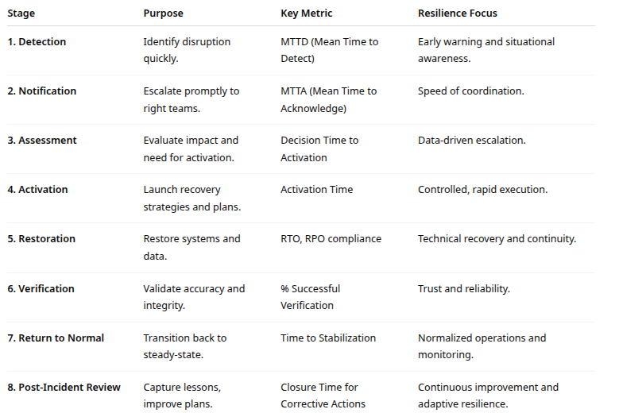
Recovery Process summary

Slide 18
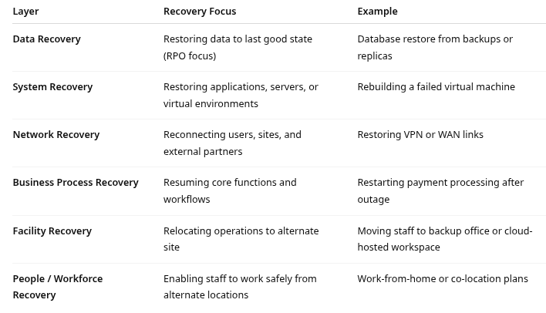
Layers of Recovery

Slide 19
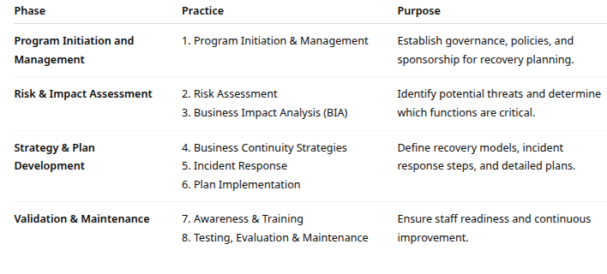
Business Recovery Life cycle
Business Recovery life cycle consists of eight interdependent practices grouped into three phases

Slide 20
Business Recovery Life cycle
Business recovery life cycle
Program initiation and governance
Secure executive sponsorship and define scope
Assign roles: Business Continuity Manager, Recovery Coordinator, IT DR Lead
Align with enterprise risk management and regulatory requirements (e.g., FFIEC, OCC)
Risk assessment
Identify threats (cyberattacks, power failure, flood, supplier outage)
Evaluate likelihood and impact
Identify single points of failure in critical operations
Business impact analysis (BIA)
Determine critical functions and their dependencies (systems, people, vendors)
Establish RTOs and RPOs
Prioritize recovery order (what must come back first)

Slide 21
Business Recovery Life cycle
Business recovery life cycle
Strategy development
Select appropriate recovery models (hot, warm, cloud, etc.) based on BIA results
Balance cost vs. recovery speed
Document technology, data, and process recovery strategies
Plan development and implementation
Create detailed Recovery Procedures / SOPs:
Activation criteria
Communication protocols
Technical recovery steps
Validation checkpoints
Coordinate with IT, facilities, HR, and external vendors.

Slide 22
Business Recovery Life cycle
Business recovery life cycle
Awareness, training, and communication
Conduct regular training for recovery and crisis response teams
Educate employees on roles during incidents
Maintain internal and external contact lists
Testing and exercising, Validate recovery plans through
Tabletop exercises (discussion-based)
Functional drills (partial system tests)
Full-scale simulations (end-to-end recovery)
Measure performance against RTO/RPO and identify improvements

Slide 23
Business Recovery Life cycle
Business recovery life cycle
Maintenance and continuous improvement
Review and update recovery plans regularly (at least annually)
Incorporate lessons learned from incidents and tests
Adjust to organizational changes, new systems, or threats

Slide 24
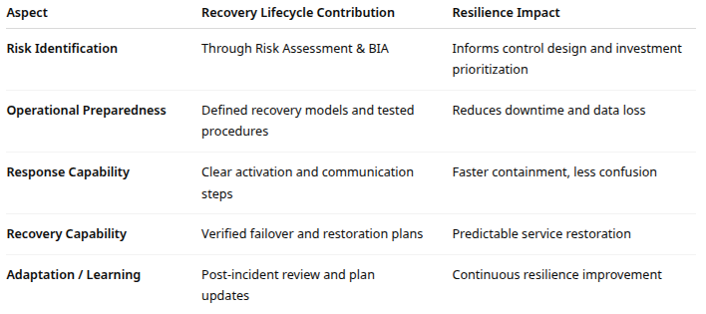
Risk and Resilience

Slide 25
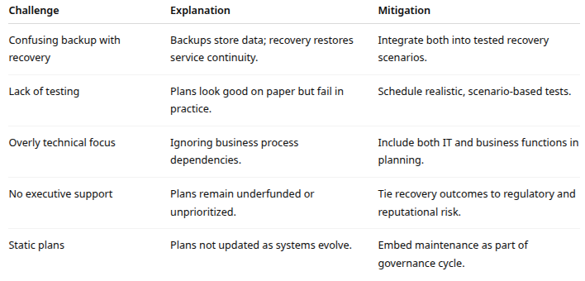
Common errors

Slide 26
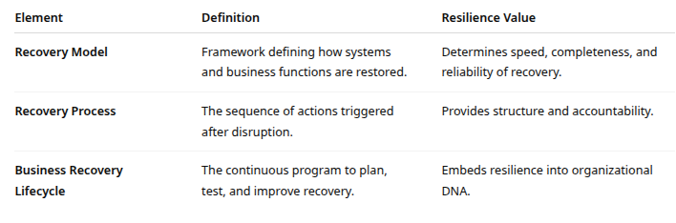
summary

Slide 27

Q&A and open discussion
Notes:
Now is the time to engage in an interactive Q&A session where you can ask questions, share insights, and clarify any doubts about the topics we have covered so far.
This open discussion is designed to ensure that every participant has the opportunity to voice their thoughts and learn from the collective experience of the group.
Your questions and comments are valuable as they help us identify areas that may need further explanation and enable us to tailor future sessions to your needs.
We encourage you to speak up and contribute to the dialogue, as this interaction is one of the key components of our interactive learning approach.
As the session progresses, take note of any questions or ideas that you would like to revisit, and feel free to share your perspectives with the class.

